Slide 1
Neighborhood, law enforcement and sociodemographic correlates of perceived stress: pilot study in St. Louis, Missouri
SAAD T. SIDDIQUI, MPH; MARIO SCHOOTMAN, PhD
College For Public Health & Social Justice, Saint Louis University

Slide 2
Background
A repetitive stress-response cycle can increase the risk of cardiovascular disease, type-II diabetes, arthritis and mental illness
Neighborhood conditions – including disorder, safety, and perception of neighborhood law enforcement – have been highlighted as important determinants of stress
St. Louis in particular has a long history of structural violence, including racial disparities, neighborhood disadvantage, and tensions with policing
Law enforcement variables play a vital role as correlates of neighborhood disadvantage in St. Louis, so it is important to investigate the association between law enforcement in St. Louis neighborhoods and psychosocial stress
This study examines such potential determinants of perceived stress in St. Louis, while controlling for sociodemographic variables

Slide 3
Research question and aim
Does perception of stress by St. Louis residents depend on neighborhood conditions and perception of law enforcement?
This study utilizes survey data from participants enrolled over social media to examine the effect of neighbourhood disorder and perception of law enforcement on perceived stress, while controlling for sociodemographic variables.

Slide 4
Methods

Slide 5

Participants and recruitment
Targeted advertisements to Facebook and Instagram users aged 18–64 years, living in St. Louis metro area (122 ZIP Codes) from February to December 2017
Link to online survey form, consent and HIPAA
Incentive provided to eligible participants who completed survey in the form of $15 Amazon Gift Cards
425 participants enrolled

Slide 6
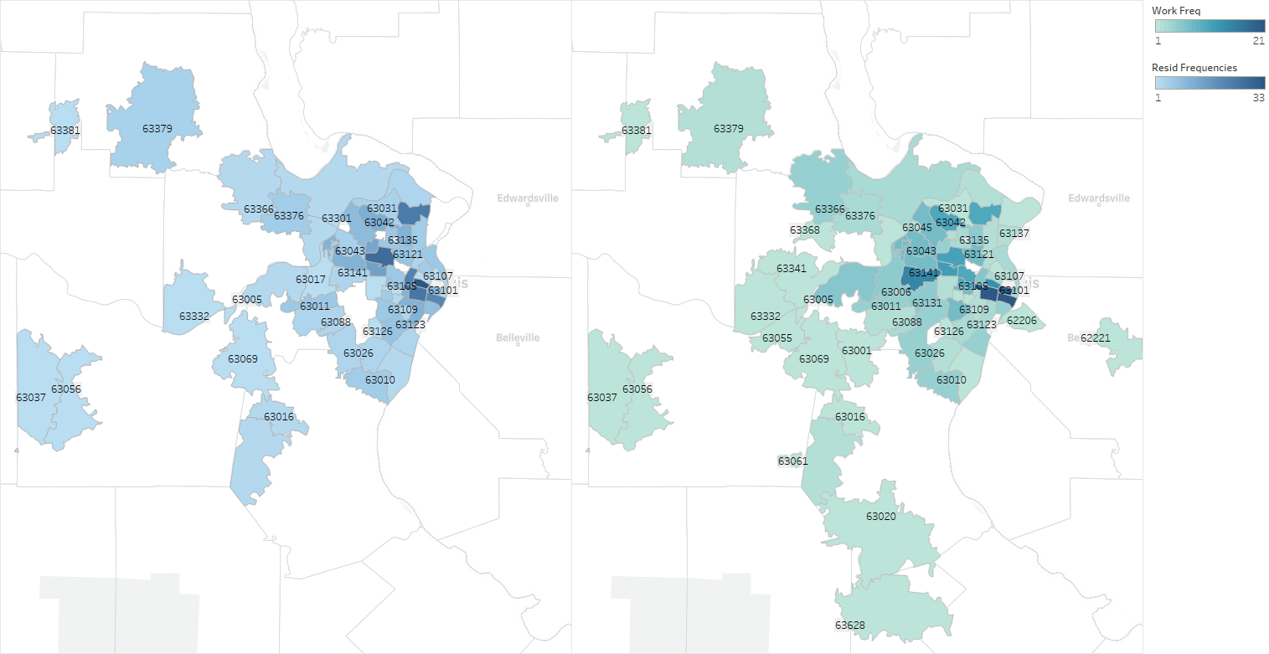
Participants and recruitment
STUDY ENROLMENT FLOWCHART
ST LOUIS ENROLMENT ZIP CODES
Reach on Facebook n = 141,293
Unique link clicks n = 2,800
Survey page visits n = 801
Excluded surveys Ineligible: n = 105 Duplicates: n = 27 Refusals: n = 5 Withdrawals: n = 34 Incomplete survey: n = 205
Completed surveys n = 425

Slide 7
Study sample
ELIGIBILE PARTICIPANTS were:
aged 18 to 64 years
spoke English
residents of St. Louis
not students
not institutionalized or residents of assisted living facilities
STUDY SAMPLE was 284 participants

Slide 8
Analysis
OUTCOME was Perceived Stress Score (PSS)
Based on Perceived Stress Scale (PSS-4)
4 items in the scale summed as a score ranging from 0 to 16; a higher score indicating higher perceived stress
PRIMARY EXPOSURE was Neighborhood Disorder Score
Adapted version of the 13-item Ross-Mirowsky Perceived Neighborhood Disorder Scale
9 items recording disorder and 4 items recording order
Higher score indicates higher disorder in the neighborhood

Slide 9
Analysis
SECONDARY EXPOSURES included social capital score, physical activity score, confidence in police, fear of crime score, police-neighborhood and collaboration score;
DEMOGRAPHIC & HEALTH characteristics included age, education, household income, having health insurance and diagnosed depressive symptoms

Slide 10
Analysis
3 LINEAR REGRESSION MODELS:
[1] Demographics and health with PSS outcome;
[2] Primary and secondary exposures with PSS outcome;
[3] Models 1 and 2 combined with PSS outcome

Slide 11
Results

Slide 12
Demographic characteristics
SAMPLE CHARACTERISTICS IN TERMS OF MEAN PSS
6.36
MEAN PERCEIVED STRESS →

Slide 13
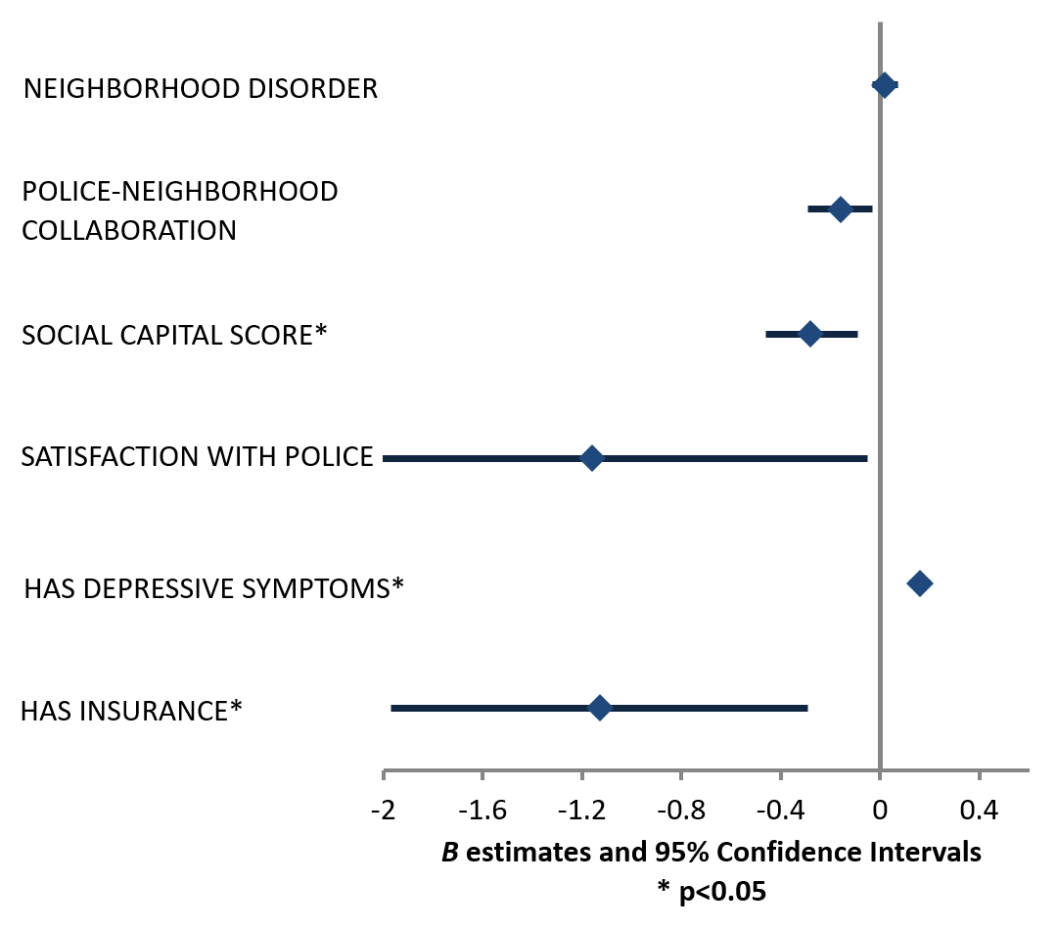
Results from Model 3

Slide 14
 | Model 1 |  |  | Model 2 |  |  | Model 3
 |  | 95% confidence interval |  |  | 95% confidence interval |  |  | 95% confidence interval
 | B | Lower | Upper | B | Lower | Upper | B | Lower | Upper
Education
High school or less | 2.29* | 0.91 | 3.67 |  |  |  | 1.05 | -0.18 | 2.28
Some college | 0.46 | -0.60 | 1.52 |  |  |  | -0.17 | -1.10 | 0.76
Associate's/Bachelor's degree | 0.04 | -0.84 | 0.92 |  |  |  | 0.04 | -0.73 | 0.81
Graduate/Professional degree (Ref) | 0 |  |  |  |  |  | 0
Household income
< $25,000 | 1.26* | 0.10 | 2.42 |  |  |  | 0.10 | -0.94 | 1.14
$25,000 to $49,999 | 1.05* | 0.08 | 2.01 |  |  |  | 0.29 | -0.57 | 1.14
$50,000 to $74,999 | 0.33 | -0.66 | 1.32 |  |  |  | -0.10 | -0.95 | 0.76
≥ $75,000 (Ref) | 0 |  |  |  |  |  | 0
Has insurance | -1.29* | -2.16 | -0.43 |  |  |  | -1.13* | -1.97 | -0.29
Days with ill mental health in previous month |  |  |  | 0.17* | 0.13 | 0.21 | 0.16* | 0.12 | 0.20
Confidence in police
Low |  |  |  | 0.37 | -0.83 | 1.57 | 0.40 | -0.80 | 1.61
Mid |  |  |  | -0.17 | -0.93 | 0.59 | -0.20 | -0.96 | 0.56
High (Ref) |  |  |  | 0 |  |  | 0
Satisfied with neighborhood police |  |  |  | -0.94 | -2.04 | 0.16 | -1.16* | -2.28 | -0.05
Neighborhood disorder score |  |  |  | 0.03 | -0.02 | 0.08 | 0.02 | -0.03 | 0.07
Police-neighborhood collaboration score |  |  |  | -0.16* | -0.29 | -0.03 | -0.16* | -0.29 | -0.03
Social capital score |  |  |  | -0.34* | -0.52 | -0.16 | -0.28* | -0.46 | -0.09

Slide 15
Discussion

Slide 16
Strengths and limitations
STRENGTHS
Participants’ willingness to provide sensitive information over an online survey
Use of validated scales to collect information that is vital in understanding neighborhood characteristics, stress, perception of police, and fear of crime
LIMITATIONS
Purposive sample of Facebook users
Due to the eligibility criteria, the study subjects may not be representative
The eligibility criteria reduced the initial sample size, thus reducing the power of the analyses that were conducted

Slide 17
Conclusions
Important associations between police variables, social capital and perceived stress
Univariate associations highlighted in the study may inform a future multivariate analysis conducted on a larger sample with more power
Perceived stress of St. Louis residents is determined to a great extent by structures such as neighborhoods and police action
Study opens avenues through which the structural violence experienced by many St. Louis neighborhoods can be prevented
neighborhood cohesion
police-neighborhood collaboration

Slide 18
Thank you!

